Slide 1

Web API & Classification Model
Jerel Novick
July 12, 2019

Slide 2

Outline
Dad Jokes
Data Collection
Models
Conclusions
Further Work
Questions

Slide 3
Dad Jokes
Corny
Generally unfunny
One liner
Reminiscent of Remarks made by middle aged or elderly fathers
Involves a pun
Sources: Wikipedia and Dictionary.com

Slide 4
Dad Jokes

Slide 5
Data Collection
17 scrapes
Jokes
2,509 Posts
Dad Jokes
1,648 Post

Slide 6
Models
Logistic regression
Grid Search
Naïve Bayes

Slide 7
Logistic Regression Model
2,000 max features
Train score 0.85338
Test score 0.59807
 | Predicted Negative | Predicted Positive
Actual Negative | 434 | 161
Actual Positive | 257 | 188

Slide 8
Grid search Model
Train score 0.90728
Test score 0.6125
 | Predicted Negative | Predicted Positive
Actual Negative | 431 | 164
Actual Positive | 239 | 206

Slide 9
Naïve Bayes
Train score 0.71671
Test score 0.58461
 | Predicted Negative | Predicted Positive
Actual Negative | 380 | 215
Actual Positive | 217 | 228

Slide 10
Conclusion

Slide 11
Conclusions
Training Models overfit
Generally better at predicting the Negative
Biased

Slide 12
Further Work

Slide 13
Further Work
 | Absolute Coefficients
Whole | 1.5740
Cow | 1.5239
Sh*t | 1.5099
Talk | 1.4071
Middle | 1.3700
Completely | 1.2928
Largest | 1.2807
Magician | 1.2795
Running | 1.2766
Happens | 1.2714

Slide 14
Further Work
More selective features
Compare against other subreddits
Tone
Puns

Slide 15
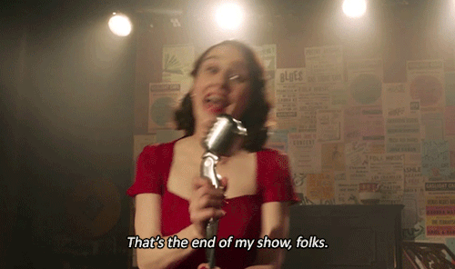
Questions

